Slide 1
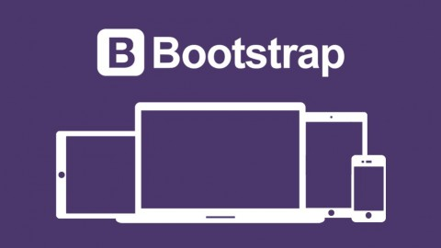
IT 353 Web Development Technologies
Jianwei Lai
jlai12@ilstu.edu

Slide 2
Content for Today
Introduction to Bootstrap
Install and use Bootstrap
Major components/features

Slide 3
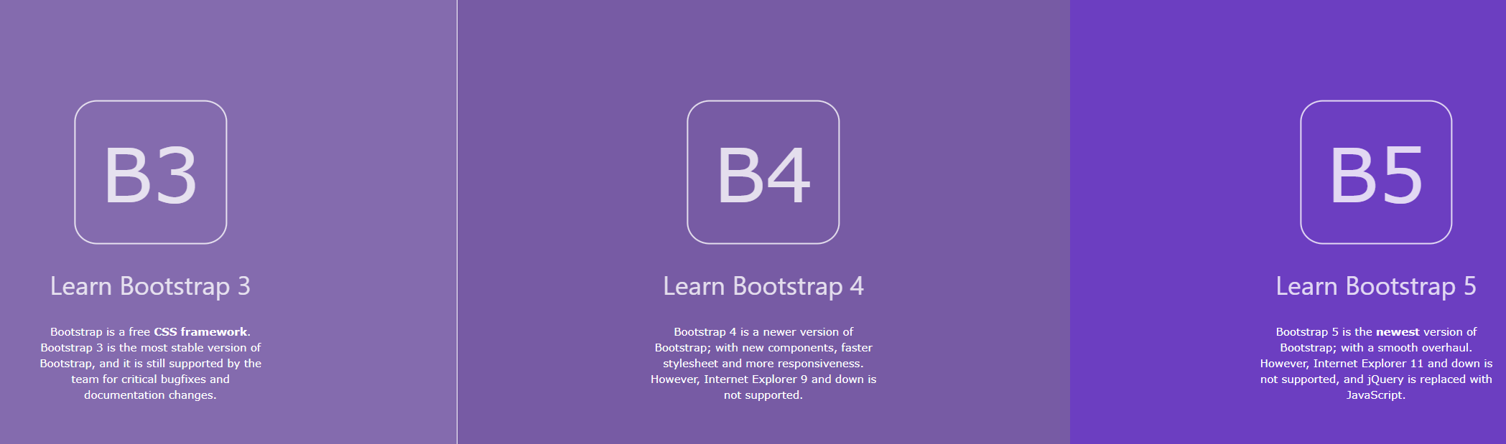
What is Bootstrap?
https://www.w3schools.com/bootstrap/bootstrap_ver.asp
https://getbootstrap.com/

Slide 4


Created By
https://github.com/mdo
https://twitter.com/fat

Slide 5
What is Bootstrap?
A design framework for websites and web applications
Based upon HTML5, CSS and JavaScript
Supports all major browsers
Originally named Twitter Blueprint, was developed by Mark Otto and Jacob Thornton at Twitter as a framework to encourage consistency across internal tools
Released on GitHub in August 2011

Slide 6
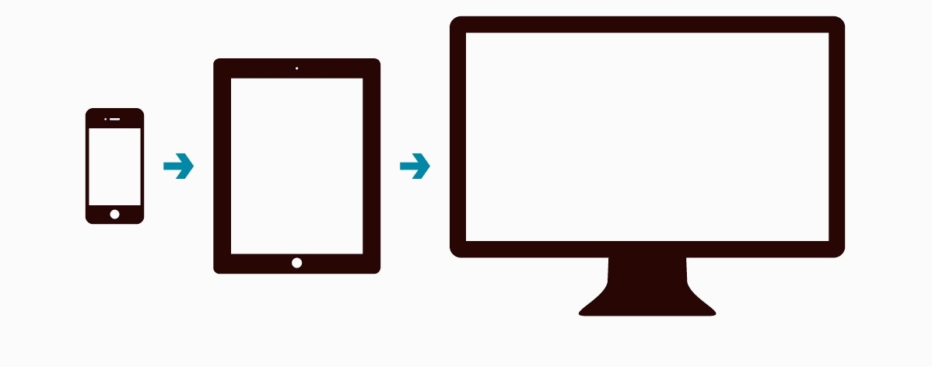
Mobile-First Strategy
>There are 4.28 billion global mobile Internet users as of January 2021
Sites built with Bootstrap (and beyond) target mobile devices and scale for larger screens depending on screen size.
Notes:
mobile first means designing an online experience for mobile before designing it for the desktop Web—or any other device.
In the past, when users’ focus was on the desktop Web, mobile design was an afterthought.
But today, more people are using their mobile devices for online shopping and social networking than ever before, therefore companies must focus on designing for mobile
https://hostingfacts.com/internet-facts-stats-2016/

Slide 7
Why Bootstrap?
Easy to use: Anybody with just basic knowledge of HTML and CSS can start using Bootstrap
Responsive features: Bootstrap's responsive CSS adjusts to phones, tablets, and desktops
Mobile-first approach: In Bootstrap, mobile-first styles are part of the core framework
Browser compatibility: Bootstrap 5 is compatible with all modern browsers (Chrome, Firefox, Edge, Safari, and Opera). Note that if you need support for IE11 and down, you must use either BS4 or BS3.
Notes:
Reason 1: The Powerful Grid System
Bootstrap has one of the best responsive, mobile first grid systems available. It’s easy to use and flexible. It helps in scaling a single website design from the smallest mobile device to high definition displays, logically dividing the screen into 12 columns, so that you can decide just how much screen real estate each element of your design should take up.
Reason 2: Rapid Development
Bootstrap comes complete with many reusable CSS and JavaScript components that can help to achieve the functionality needed in almost any kind of website. You just have to use some HTML to plug them into your template, with no need to spend huge amounts of time writing complex CSS and JavaScript. Plus, all these components are responsive, too!
Reason 3: Browser Compatibility
Bootstrap is compatible with all modern browsers and Internet Explorer versions 8 and up. If Bootstrap’s instructions are followed properly, you can create a website design that works in all these browsers. Plugins like HTML5Shiv and Respond.jscome as part of Bootstrap’s default template. These help in porting HTML5 elements into older non-HTML5 browsers.
Of course, if your employer wants to make a website compatible with IE7, then it might be time to think about switching jobs!
Reason 4: Customization!
Bootstrap offers many ways to customize its default design. You can override all of its CSS and default JavaScript behaviour. Bootstrap is even more interesting if you are a Less or Sass developer, as it includes Less and Sass customization options. These options let you smoothly create a new template using Bootstrap.
Reason 5: Open Source
Bootstrap is an open source project, hosted on Github. It is released under the MIT license. This is one of the biggest reasons that I use Bootstrap. My clients won’t have to deal with purchasing and licensing issues, and Bootstrap’s license gives me the freedom to completely change and experiment with it.
https://www.sitepoint.com/why-i-love-bootstrap-you-should/
https://bootstrapbay.com/blog/reasons-to-use-bootstrap/

Slide 8

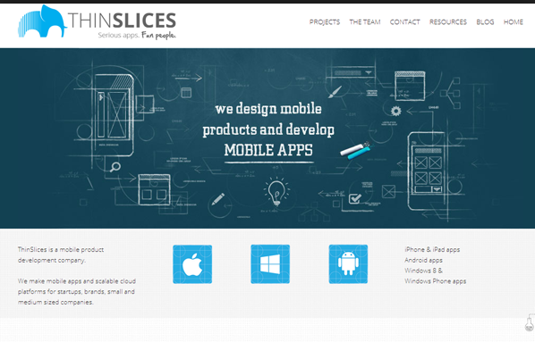
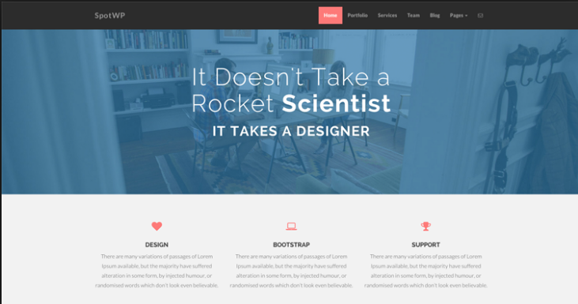

Slide 9
Where to Get Bootstrap 5?
Two ways
Include Bootstrap 5 from a CDN
Download Bootstrap 5 from getbootstrap.com

Slide 10
Bootstrap 5 CDN
MaxCDN
<!-- Latest compiled and minified CSS -->
<link href="https://cdn.jsdelivr.net/npm/bootstrap@5.1.1/dist/css/bootstrap.min.css" rel="stylesheet">
<!-- Latest compiled JavaScript -->
<script src="https://cdn.jsdelivr.net/npm/bootstrap@5.1.1/dist/js/bootstrap.bundle.min.js"></script>
Notes:
One advantage of using the Bootstrap 5 CDN: Many users already have downloaded Bootstrap 5 from jsDelivr when visiting another site. As a result, it will be loaded from cache when they visit your site, which leads to faster loading time. Also, most CDN's will make sure that once a user requests a file from it, it will be served from the server closest to them, which also leads to faster loading time. JavaScript? Bootstrap 5 use JavaScript for different components (like modals, tooltips, popovers etc). However, if you just use the CSS part of Bootstrap, you don't need them.

Slide 11
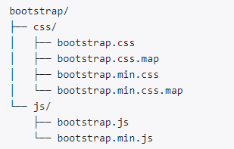
Download
This is the most basic form of Bootstrap: pre-compiled files for quick drop-in usage in nearly any web project.
They provide compiled CSS and JS (bootstrap.*), as well as compiled and minified CSS and JS (bootstrap.min.*).
CSS source maps (bootstrap.*.map) are available for use with certain browsers’ developer tools.
Precompiled Bootstrap
https://getbootstrap.com/

Slide 12
Get started with Bootstrap
<!DOCTYPE html> <html lang="en"> <head> <title>Bootstrap 5 Example</title> <meta charset="utf-8">
<meta name="viewport" content="width=device-width, initial-scale=1"> </head> </html>
Notes:
The width=device-width part sets the width of the page to follow the screen-width of the device (which will vary depending on the device).
The initial-scale=1 part sets the initial zoom level when the page is first loaded by the browser.

Slide 13
Add Bootstrap CDN links to the head section
<link href="https://cdn.jsdelivr.net/npm/bootstrap@5.1.1/dist/css/bootstrap.min.css" rel="stylesheet"> <script src="https://cdn.jsdelivr.net/npm/bootstrap@5.1.1/dist/js/bootstrap.bundle.min.js"></script>

Slide 14
Add the “container” or “container-fluid” class to the body
<body> <div class="container"> <h1>My First Bootstrap Page</h1> <p>This part is inside a .container class.</p> <p>The .container class provides a responsive fixed width container.</p> </div> </body>
Notes:
The .container class provides a responsive fixed width container
The .container-fluid class provides a full width container, spanning the entire width of the viewport

Slide 15
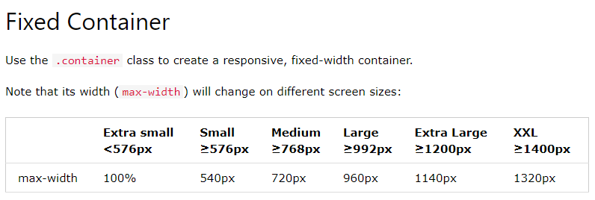
Container
Bootstrap requires a containing element to wrap site contents.
There are two container classes to choose from:
The .container class provides a responsive fixed width container
The .container-fluid class provides a full width container, spanning the entire width of the viewport

Slide 16
Try it out
https://www.w3schools.com/bootstrap5/tryit.asp?filename=trybs_gs_container-fluid&stacked=h
Notes:
Change container-fluid to container

Slide 17
Container Padding
By default, containers have left and right padding, with no top or bottom padding. Therefore, we often use spacing utilities, such as extra padding and margins to make them look even better. For example, .pt-5 means "add a large top padding":
<div class="container pt-5"></div>
Notes:
Check the bootstrap css file to see what pt-5 is
Change to pit-1 to 4
.pt-5 { padding-top: 3rem !important;}
p-5

Slide 18
.pt-5 { padding-top: 3rem !important;}
!important --it will override ALL styling rules for that specific property on that element!
https://www.w3schools.com/css/tryit.asp?filename=trycss_important

Slide 19
rem vs em
Both rem and em are relative units, px is not.
While em is relative to the font-size of its parent, rem is only relative to the html (root) font-size.
https://j.eremy.net/confused-about-rem-and-em/
Notes:
<!DOCTYPE html>
<html>
<head>
<style>
html{
font-size:16px;
}
.parent {
font-size:15px;
}
.child {
font-size: 2rem;
}
</style>
</head>
<body>
<div class="parent">
I'm 15px
<div class="child">
I'm 30px, as expected
<div class="child">
I'm 60px, trouble starts!
<div class="child">
I'm 120px, now we're really in trouble!
</div>
</div>
</div>
</div>
</body>
</html>
If the root font size is not defined, the browser’s default one will be used
Change rem to em

Slide 20
Container Border and Color
<div class="container p-5 my-5 bg-primary text-white"></div>
my-5
bg-dark
https://www.w3schools.com/bootstrap5/tryit.asp?filename=trybs_container_color&stacked=h
Notes:
my y, margin on the top and bottom
mx, x, margin on the left and right

Slide 21
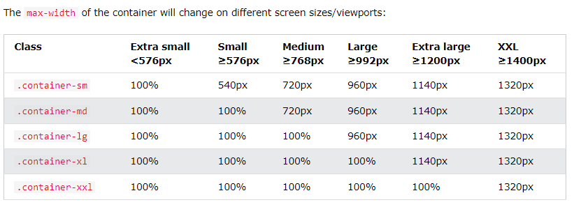
Responsive Containers
Use the .container-sm|md|lg|xl classes to determine when the container should be responsive
Notes:
https://www.w3schools.com/bootstrap5/bootstrap_containers.php
https://getbootstrap.com/docs/4.4/layout/overview/
Breakpoint for container and container-sm is the same

Slide 22
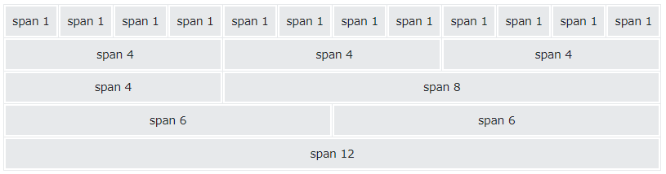
Grid System
The grid system is responsive, and the columns will re-arrange automatically depending on the screen size.
Make sure that the sum adds up to 12 or fewer (it is not required that you use all 12 available columns).
Notes:
Bootstrap is using a grid system base on 12 columns.
What is a grid system? A grid system is a way to create a solid foundation to build your project on.
If you want your web application to have a left navigation you could design your HTML using row number 3
If you do not want any navigation and you want your content to be as wide as possible then you could use row number 5
This grid design was popularized by 960 grid system http://960.gs and BluePrint http://www.blueprintcss.org

Slide 23
Grid Classes
The Bootstrap 5 grid system has six classes:
.col- (extra small devices - screen width less than 576px)
.col-sm- (small devices - screen width equal to or greater than 576px)
.col-md- (medium devices - screen width equal to or greater than 768px)
.col-lg- (large devices - screen width equal to or greater than 992px)
.col-xl- (xlarge devices - screen width equal to or greater than 1200px)
.col-xxl- (xxlarge devices - screen width equal to or greater than 1400px)
https://www.w3schools.com/bootstrap5/tryit.asp?filename=trybs_grid_ex2&stacked=h
Notes:
https://www.w3schools.com/bootstrap5/bootstrap_containers.php
It is important to include <div class="row">
Try to remove the div
How to take 10 spans for small devices
How to take half and half for large screen devices

Slide 24
Equal Columns
<div class="row"> <div class="col">.col</div> <div class="col">.col</div> <div class="col">.col</div> </div>
https://www.w3schools.com/bootstrap5/tryit.asp?filename=trybs_grid_ex&stacked=h

Slide 25
Download examples
https://getbootstrap.com/docs/5.0/examples/

Slide 26
Some practice
Apply Bootstrap to the index page of the example project from Reggienet
Make the index page responsive

Slide 27
Add meta and bootstrap
<meta charset="utf-8">
<meta name="viewport" content="width=device-width, initial-scale=1">
<link href="https://cdn.jsdelivr.net/npm/bootstrap@5.1.1/dist/css/bootstrap.min.css" rel="stylesheet"> <!-- Latest compiled JavaScript --> <script src="https://cdn.jsdelivr.net/npm/bootstrap@5.1.1/dist/js/bootstrap.bundle.min.js"></script>

Slide 28

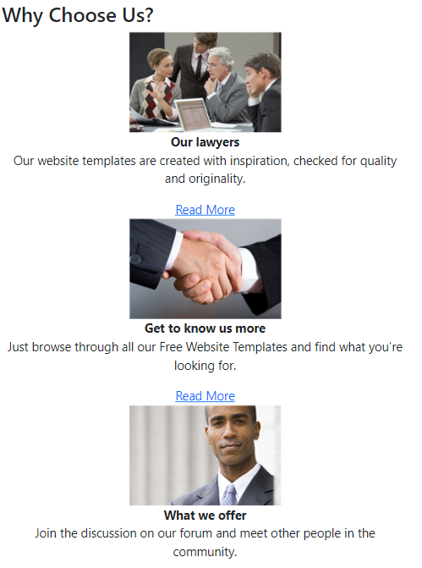

Make the “why choose us” section responsive
Notes:
col-md-6 col-lg-3

Slide 29

How to make the picture responsive and center the text?
Notes:
Width=“100%”
<div class="row text-center">

Slide 30
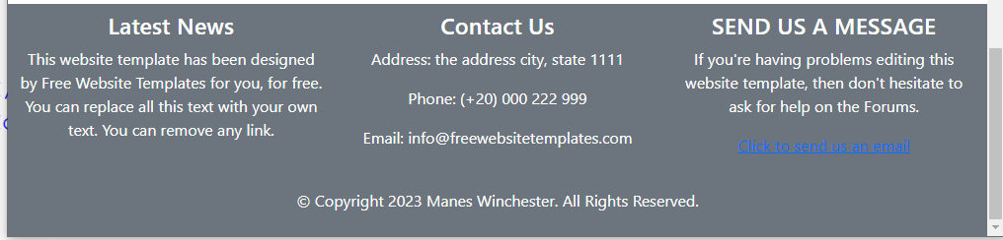
Footer section
Make the footer section take the whole width of the screen
Make it responsive
How to change the background color to lightgray
Notes:
Need to put the footer section outside the “container” class then make it “container-fluid”
<div id="footer" class="container-fluid text-center text-white bg-secondary pt-2 pb-2">
<div class="row">
<div class="col-md-4">
style="background-color: lightgray; need to remove the bg-secondary class
You can also use an external css style file

Slide 31
Try to make your project website responsive

